Slide 1
RUNGTA COLLEGE OF DENTAL SCIENCES & RESEARCH
DEPARTMENT OF CONSERVATIVE DENTISTRY AND ENDODONTICS
1

Slide 2
Specific learning Objectives
At the end of this presentation the learner is expected to know ;
Core areas* | Domain ** | Category #
ANATOMY OF PERIAPEX CEMENTUM PERIODOTAL LIGAMENT INGLES CLASSIFICATION ZONES OF FISH | COGNITIVE | MUST KNOW
PATHWAY OF ENTRY OF MICROORGANISMS IN TOOTH | PSYCHOMOTOR | NICE TO KNOW
DIAGNOSIS OF PERIAPICAL TISSUE ENDO PERIO LESSIONS | AFFECTIVE | DESIRE TO KNOW

Slide 3
Contents
Introduction
Contacts
Definition of contact area
Types of contacts
Proximal Contact Area
Contact areas based on Shape of tooth
Changes in contact with age
Hazards of faulty reproduction of contact of teeth in restorations
Open contacts
Contours
Functions of contour
Height of Contour
3

Slide 4
Types of contour
Functions of contour
Age changes
Hazards of improper proximal contour relationship
Hazards of improper contours on restoration
Management of improper contours
Embrasures
Functions of embrasures
Hazards of faulty embrasures
Marginal ridges
Functions
Procedures for formulation of proper contacts and contours:
Tooth movement
Objectives

Slide 5
Rapid / Immediate movement
Methods
Wedge method
Classification of wedges
Functions of wedges
Wedging techniques
Error’s with wedge placement
Test for proper wedge placement
Elliots separator
Traction method
Non-Interfering true separator
Ferrier double-bow separator
5

Slide 6
Slow/ Delayed tooth movement
Methods:
Separating wires
Oversized temporaries
Orthodontic appliances
Matricing
Classification of matrices
Matrix Band and retainer
Qualities of a good matrix
Universal Matrix (Tofflemire matrix)
Ivory Matrix No.1
Ivory Matrix No. 8
Black’s matrices
Copper Band Matrix / Soldered Band

Slide 7
Anatomical Matrix
Roll in band matrix ( Automatrix)
S-shaped Matrix Band
T-shaped matrix
Mylar Strips
Aluminium Foil Incisal Corner Matrix
Transparent Crown Form Matrix
Window Matrix
Preformed Transparent Cervical Matrix
Recent Advances
Contact Forming Instruments
Contact Rings
First generation systems
Second - Generation Rings
Metafix Matrix System
Bioclear Matrix system
Fender Wedges
Slick Bands
Conclusion
References
Notes:
Palodent Bitine
Contact matrix
Composi-Tight
Composi-Tight 3D soft face ring system
V3 ring system

Slide 8
Presence of proper contacts & contour is important to maintain stability & occlusal harmony.
A thorough knowledge of the contacts & contours of various teeth is mandatory for understanding:
Predisposing factors of proximal caries like faulty interrelationships.
Significance of marginal ridges, embrasures for re-establishing the form and function of restored teeth.
Periodontal aspect & health of the tooth to be restored.
8

Slide 9
Benefits of an ideal contact & contour:
Conserves the health of peridontium
Prevents food impaction
Makes area self cleansable
Improves longevity of proximal restorations
Maintains normal mesiodistal relationship of the teeth in the dental arch
6

Slide 10
Role of a dentist is to establish the ideal extension so as to perform optimal functions, maintaining the integrity and longevity of individual tooth.
7

Slide 11
Food we consume moves in 3 different directions:
Occlusal surfaces
Contact & Gingival embrasures
Facial & Lingual sulcus
11
Notes:
From the cariogenic aspect there may be only twenty occlusal surfaces but there are sixty contacting proximal and 64 facial and lingual surface that are suspectible to decay in the full complement of teeth. Decay on the proximal however, occurs mainly due to the faulty inter relationship between the contact area, marginal ridges, embrasures and the gingiva..

Slide 12
Any decay occurring on the proximal surface is mainly due to faulty interrelationship between
Contact Areas
Marginal Ridges
Embrasures
Gingiva.
12

Slide 13
Time of eruption: only contact point
Proximal Contact Point
Proximal Contact Area
13

Slide 14
Proximal Contact Area
Contact areas are the places on the proximal surfaces of tooth crowns where a tooth touches the tooth adjacent to it in the same arch when the teeth are in proper alignment. (By Lewis J. Claman).
Proximal contact area denotes the area of proximal height of contour of mesial or distal surfaces of a tooth that touches or contacts its adjacent tooth in the same arch. (Sturdevent)
14

Slide 15
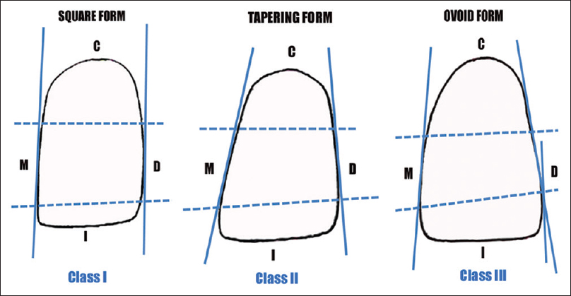
According to their general shape, 3 types:
Tapering teeth
Square type
Ovoid type
: Wide crowns & narrow cervical region
: Bulky, angular with little rounded contour
: A transitional type between tapering & square types
Notes:
Surfaces are convex but infrequently they may be concave

Slide 16
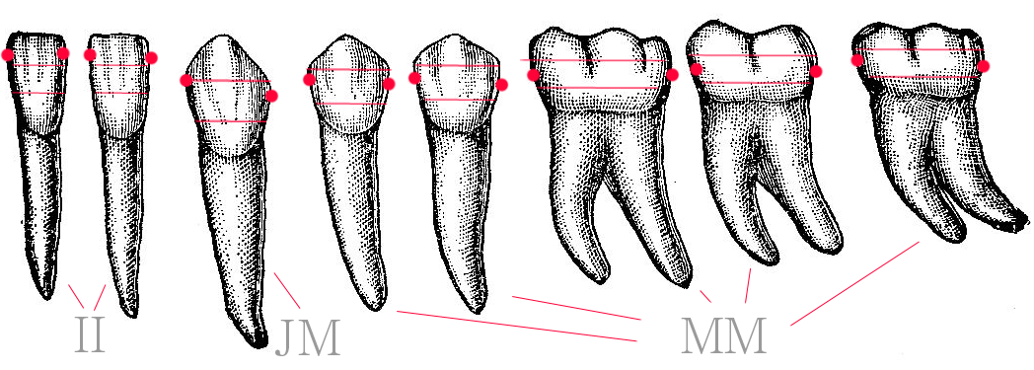

Slide 17
CONTACT | TAPERING | SQUARE | OVOID
Between Incisors | Contacts starts at incisal ridge & labial, labiolingually | Starts at incisal ridge & incline with it labiolingually | Slightly lingual to incisal ridge
 |  |  | Mesial contact start at 1/4th of crown incisogingivally
 |  |  | Distal contact start 1/3rd to ½ of crown incisogingivally
Canine | Mesial: incisal ridge Distal: middle third Very angular | Close to incisal ridge incisally | Close to incisal ridge incisally
Bicuspids | Buccal periphery is almost at bucco-axial angle | Buccal periphery more towards bucco-axial angle | Buccal periphery at junction of buccal & middle third
 | Occlusal periphery at junction of occlusal & middle 3rd of crown | Occlusal periphery at occlusal third | Occlusal periphery towards middle third
 | Contact deviated buccally | Short cusps
17
Notes:
In posteriors it has to be explained both buccolingually and occlusogingivally

Slide 19
CONTACT | TAPERING | SQUARE | OVOID
Molars (mesial contact) | Buccal periphery almost at bucco-axial angle of tooth | Same as premolars | Same as premolars
 | Occlusal periphery at junction of occlusal & middle third of crown
 | Large cusps
Molars (distal contact) | Buccal periphery at middle third | More lingually deviated than mesial | Buccal periphery in line with central groove
Embrassures | Wide variations Incisal & labial are negligible | Incisal, lingual, occlusal & buccal embrasures are NIL | Incisal, labial, buccal & occlusal embrasures are wider & deeper
 | Gingival & lingual embrasures between anterior teeth are the widest & longest in the mouth | Gingival embrasures are almost not noticeable | Gingival & lingual are short & broad
 | - Buccal embrasures are small, lingual are long
19

Slide 20
Age changes
In newly erupted teeth.
The teeth wear by rubbing against one another
With use and age, the contact point between adjacent teeth change their nature.
By age 40 in a healthy mouths with complete dentition, 10 mm of enamel has been worn off the contact area of the teeth in the arch.
This averages 0.38 mm per contact area on each tooth and certainly emphasizes the amount of proximal attrition that occurs.
Notes:
the contact points are limited in size and are circular or slightly oval in form
as they move slightly in their sockets during mastication, contact area becomes more extensive form to flattened surface of the contact.

Slide 21
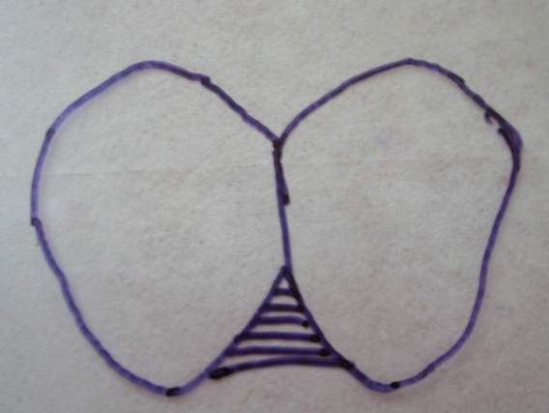
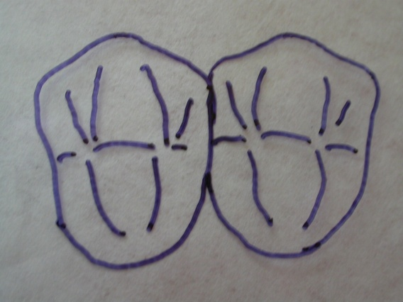
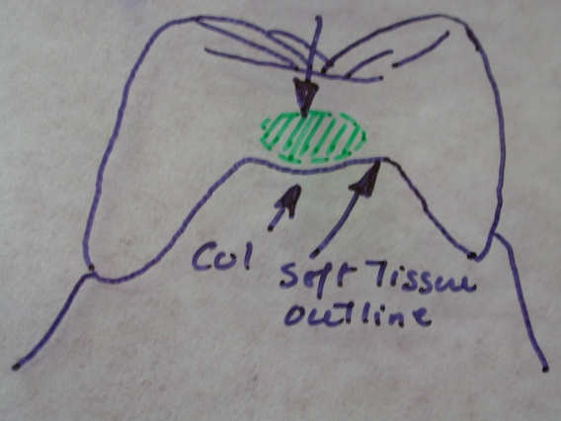
Hazards of faulty reproduction of contact of teeth in restorations
Contact size
Broad contact area
Change in anatomy of interdental col.
Normal saddle shape -> broadened.
Incipient periodontal disease is markedly increased
Inter dental papilla
Patient less able to clean the inter dental area.
Increase the area susceptible to decay
Papillary area becomes inflammed and edematous
Notes:
Col is a valley like depression that connects the facial and lingual papillae

Slide 22
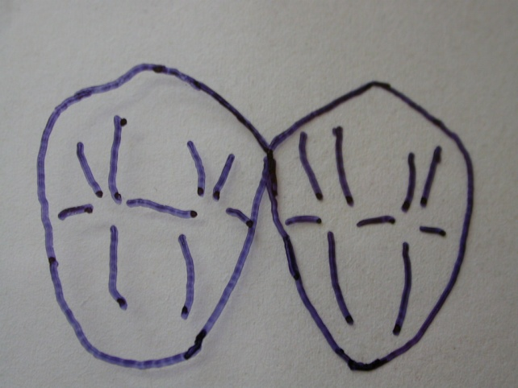
Embrasures
Improper movement or flow of masticated material
Lead to adhesion of debris and possible impaction of that debris.
Restoration could encroach physiomechanically on the periodontium predisposing to its destruction
Narrow contact area
Changes anatomy of the tooth.
Allows food to be impacted vertically or horizontally on the delicate non keratinized epithelial col.
Greater susceptibility for microbial plaque accumulation which predispose to the same periodontal and caries problems.

Slide 23
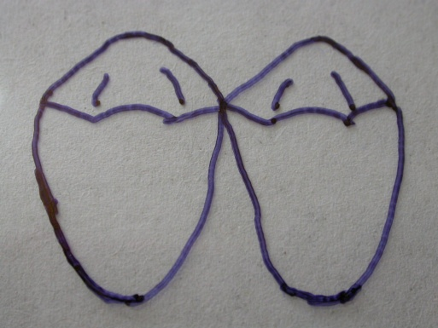
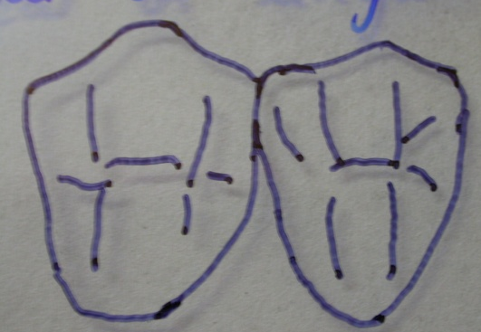
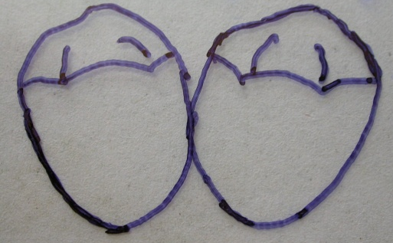
Location
Too occlusally -> flattened marginal ridge at the expense of the occlusal embrasures.
Too buccally or lingually -> flattened restoration at the expense of buccal or lingual embrasure.
Too gingivally -> increase the depth of occlusal embrasure at the expense of contact areas own size or at the size of broadening or impinging interdental col.

Slide 24
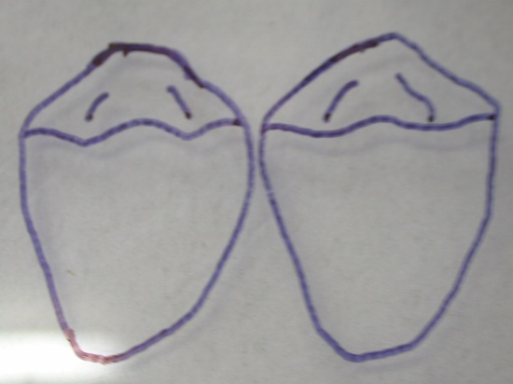
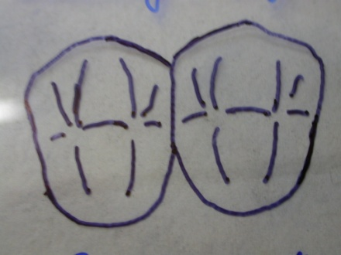
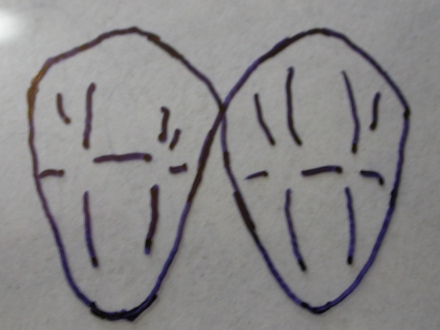
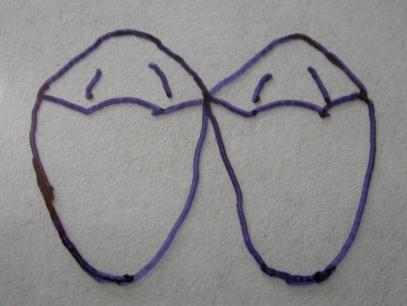
Loose or open contact area
Continuity of the embrasures with each other and with interdental col.
Contact configuration
Flat -> broad buccally, lingually or gingivally.
Excessive convexity -> Diminish the extent of contact area.

Slide 25
Leads to
Broadening and mislocating contact area
Immobilize the contacting teeth.
Depriving them of normal stimulating physiological movements.
Periodontitis and mechanical breakdown.
Impossible to create the proper size of marginal ridge or adjacent occlusal anatomy.

Slide 26
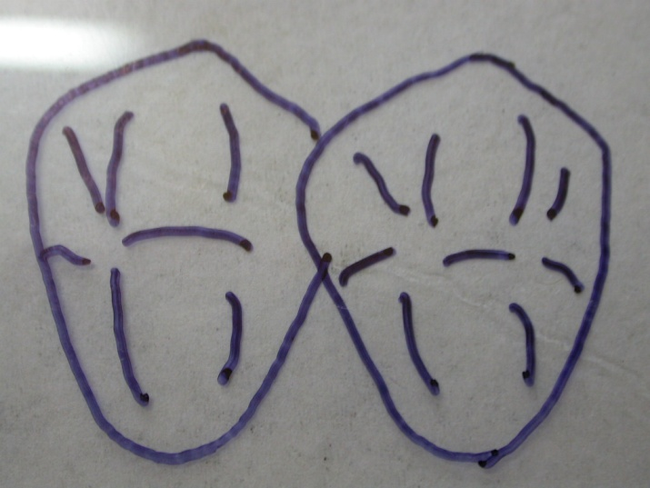
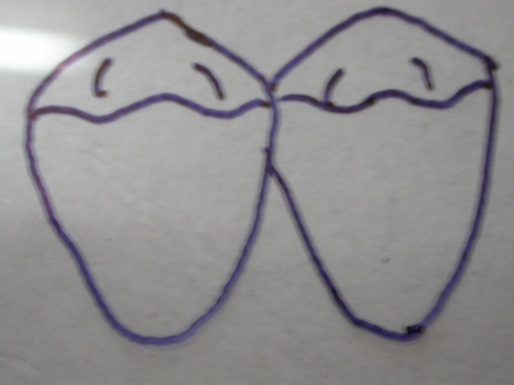
Concavity -> Occurs in restoring adjacent teeth simultaneously
Adjacent restoration with convex proximal surface

Slide 27
Open contacts
Clinical findings
Food impaction / retention
Gingival recession
Gingival inflammation
Fractured restoration
Faulty occlusion -> distal migration of untreated tooth
Gingival irritation
Periodontal complication -> acute abscess or bone loss.
Shifting of teeth (mesial drift).
Examination of proximal contact relationship
Visual inspection
Digital test
Radiographic -> paralleling technique

Slide 28
Visual inspection
Viewing the contact from the occlusal and incisal areas allows an evaluation of the contact and adjacent tooth contour.
Viewing the contact from the buccal or lingual aspect in either aspect with the aid of a mirror to reflect light into the area is extremely helpful.
Digital test
A fine unwaxed dental floss is a valuable aid in the assessment of the breadth of contact and its lightness.
This test is made by first passing the floss obliquely through the buccal embrasure and judging the cervical and lingual extent of the contact as the floss is removed.

Slide 29
Management
Replace restoration using either same restorative material or different material.
Place new restoration in adjacent tooth
Adjust occlusion.

Slide 30
TAKE HOME MESSEGE
Some of the problems that dentists face in their clinical practice are caused or facilitated by improper (but sometimes even proper) treatment of the root canal system. In an attempt to accomplish the major goals of root canal treatment, namely to prevent and/or to control endodontic infections, clinicians use procedures, substances and materials that may induce some degree of injury to the periradicular tissues. Invariably, periradicular tissue healing will occur uneventfully in cases where microorganisms were successfully eliminated from and/or prevented from gaining entry into the root canal system and minimal or no damage was inflicted on the periradicular tissues during therapy. The worst-case scenario for periradicular tissue response to intra-canal procedures is reflected largely in post-operative pain and persistence of periradicular disease despite treatment. While the development of post-operative pain is largely a short-term response related to the extent of tissue injury, post-treatment disease is a long-term response influenced by the persistence of the source of injury. Even though chemical and mechanical factors can be involved with unfavorable responses of the periradicular tissues to intracanal procedures, microorganisms are the major causative agents of post-operative pain and posttreatment disease.

Slide 31
Question: What are hazards of faulty restoration?

Slide 32
References
Operative Dentistry – MA Marzouk
Art & science of operative Dentistry – Sturdevants (5th edition)
Art & Science of Operative Dentistry – Sturdevants (South Asian Edition)
Textbook Of Operative Dentistry – Vimal K Sikri (1st Edition)
Dental Anatomy, Physiology & Occlusion – Wheeler’s (9th Edition)
Optimizing tooth form with direct posterior composite restorations JCD Oct-Dec 2011 | Vol 14 | Issue 4
32

Slide 33
117

